Slide 1

Large Language Models: Revisiting Few Mysteries
Daniel Khashabi

Slide 2
Please don’t hesitate to stop me and ask questions.

Slide 3
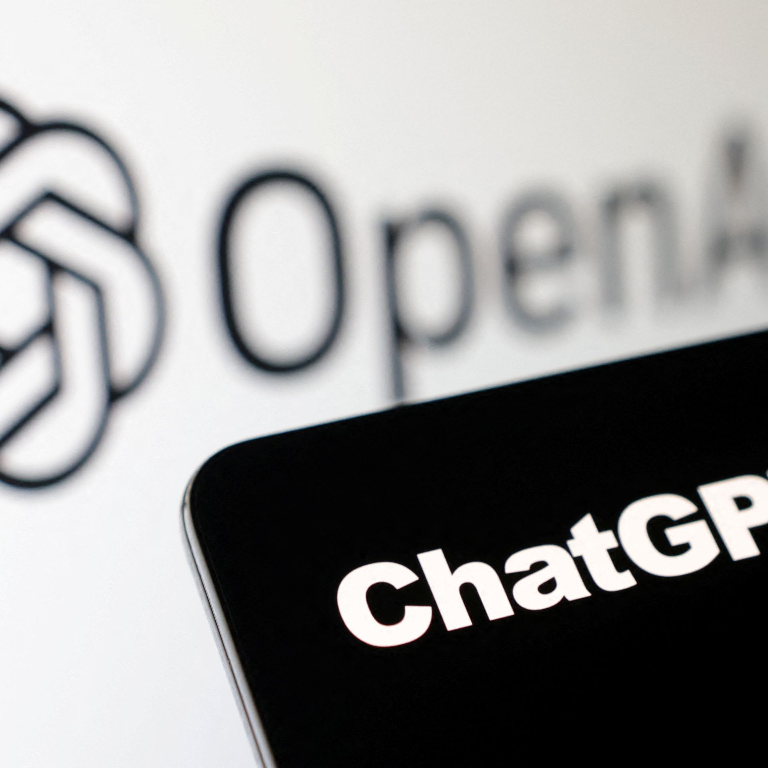
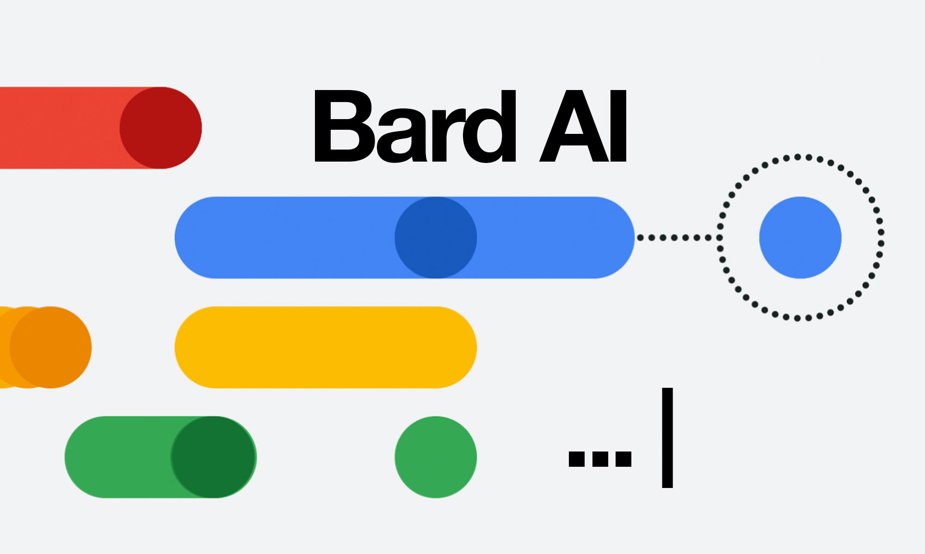


The success we dreamed of
Language models that are remarkably capable at solving many important NLP benchmarks.

Slide 4
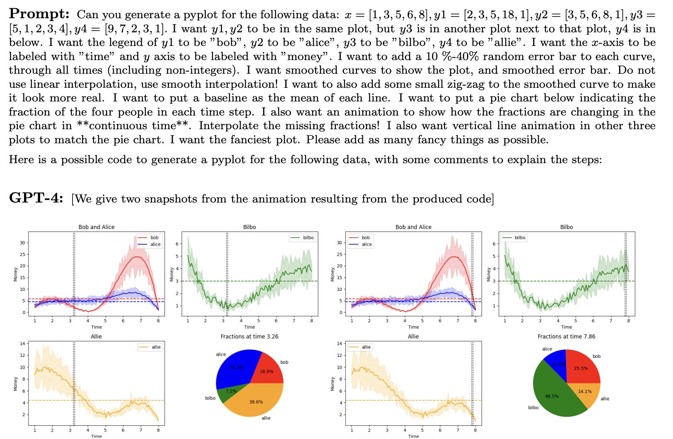
The success we dreamed of
[Bubeck et al. 2023]

Slide 5
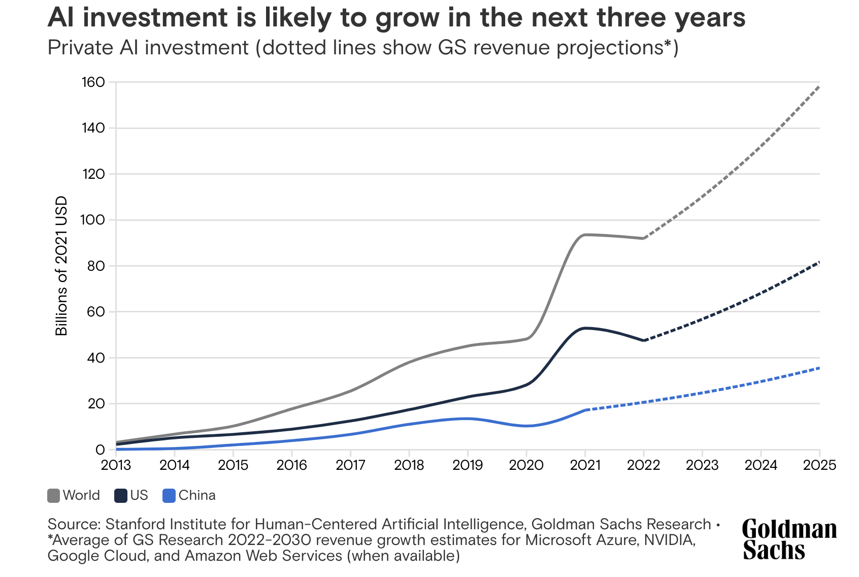
Accelerated Industrialization of AI

Slide 6
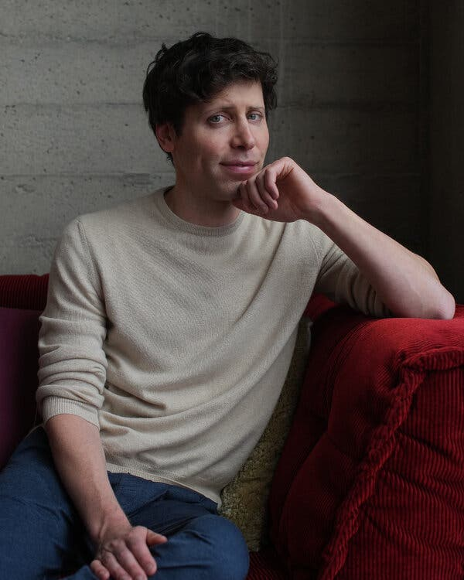

Accelerated Industrialization of AI
Accelerated industrialization of AI based on market competition entails diverging missions.

Slide 7
Remarkable progress but many questions remain open.
Questions about
optimality of architectures,
limits of their controllability,
scope of machine innovations,
effective interaction with humans, … .
Today: Revisit two interrelated technological pieces that deserve further deliberation.

Slide 8
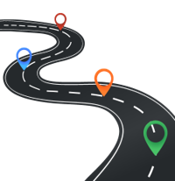
Today
Revisiting …
In-Context Learning
Alignment of chatbots

Slide 9
Today
Revisiting …
In-Context Learning
Alignment of chatbots

Slide 10
Language Models
Background
Input
text
LM
Output
text
[Bengio et al. ‘04, Peters et al. ‘18, Raffel et al. ‘20, Brown et al. ’20, many others]

Slide 11
Language Models
Background
0.2
-0.4
0.1
0.0
-0.5
Input
text
Output
text
[Bengio et al. ‘04, Peters et al. ‘18, Raffel et al. ‘20, Brown et al. ’20, many others]

Slide 12
Language Models
Background
Johns Hopkins University is in _______.
LM
Baltimore
Simple facts
[Bengio et al. ‘04, Peters et al. ‘18, Raffel et al. ‘20, Brown et al. ’20, many others]

Slide 13
In-context learning emerges from pre-training
Background
Input: JHU Output: Baltimore
Input: UMD Output: DC
Input: NYU Output:
LM
New York
[Brown et al., 2020]

Slide 14
In-context learning emerges from pre-training
Background
Input: JHU Output: Baltimore
Input: UMD Output: DC
Input: NYU Output:
LM
New York
Input: JHU Output: private
Input: UMD Output: public
Input: NYU Output:
LM
private
[Brown et al., 2020]

Slide 15
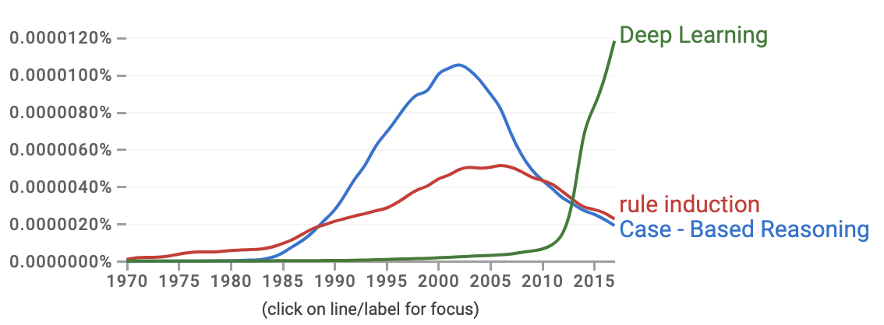
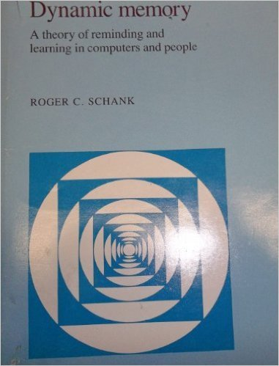
This is an old dream come true!
Background
Case-based reasoning, rule-induction, dynamic memory, analogical reasoning, …
[Google n-grams]

Slide 16
In-context learning: well-studied yet elusive.
What we understand:
ICL improves with scale. [Brown et al. 2020; Srivastava et al. 2023]
ICL is brittle. [Min et al., 2022; Mishra et al., 2022]
ICL as a probabilistic inference. [Muller et al. 2021; Xie et al. 2021]
Still no framework that fully explains and predicts its nuts and bolts.

Slide 17

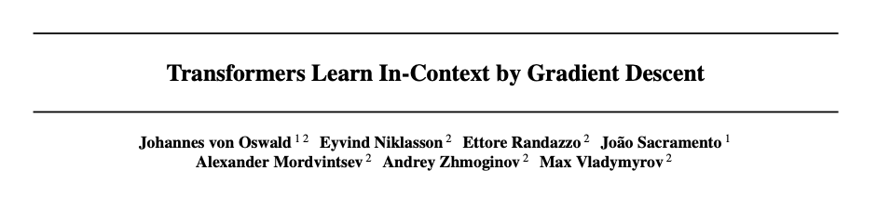
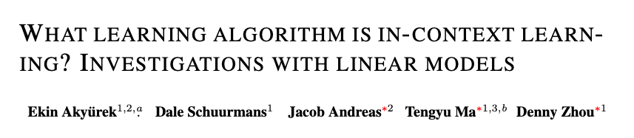
Explaining ICL via Gradient Descent
Is it possible that ICL is secretly executing GD during inference?
We have known GD for a long-time.
ICML 2023
Dai et al. 2022; Garg et al. 2022; Zhang et al. 2023; Ahn et al. 2023; Raventos et al. 2023; Li et al. 2023; Guo et al. 2023; …
ICLR 2023

Slide 18
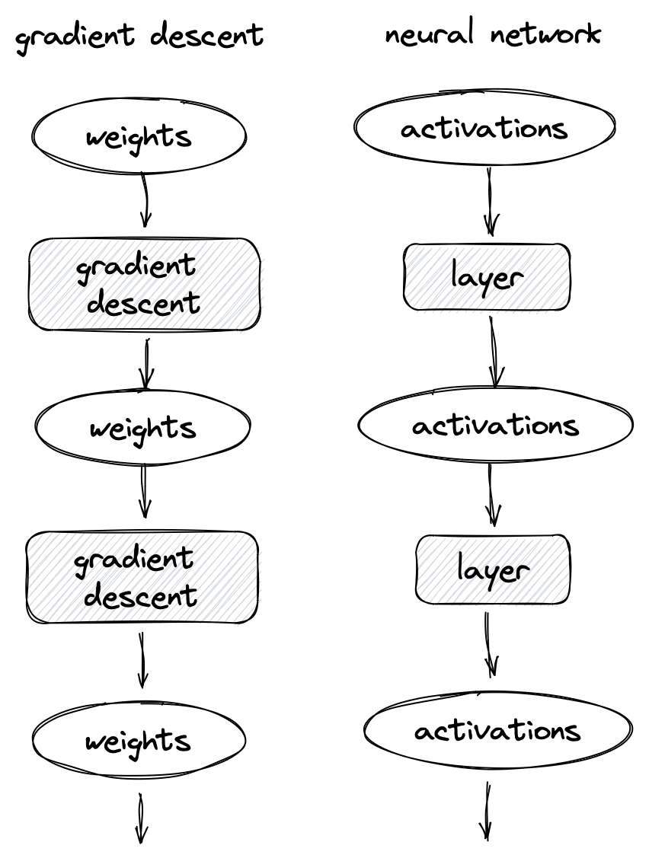
Basic idea: gradient computation in forward process
Gradient descent
Forward propagation
(photo credit: Blaine on lesswrong)

Slide 19



A Self-Attention (SA) Layer
$$h_{}^{out}=SA(h_{}^{in}; W_{q}, W_{k}, W_{v})$$
$$h_{}^{out}$$
Self-Attention Layer
$$h_{}^{in}$$

Slide 20
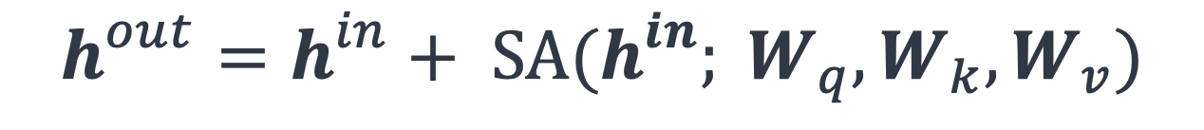
A Self-Attention (SA) Layer
$$h_{}^{out}=h_{}^{in}+ SA(h_{}^{in}; W_{q}, W_{k}, W_{v})$$
$$h_{}^{out}$$
Self-Attention Layer
$$h_{}^{in}$$

Slide 21

A SA Layer vs. a GD update
$$h_{}^{out}=h_{}^{in}+ SA(h_{}^{in}; W_{q}, W_{k}, W_{v})$$
Each layer simulate an implicit gradient update?
$$w_{}^{t+1}=w_{}^{t}−η×∇ℒ$$

Slide 22
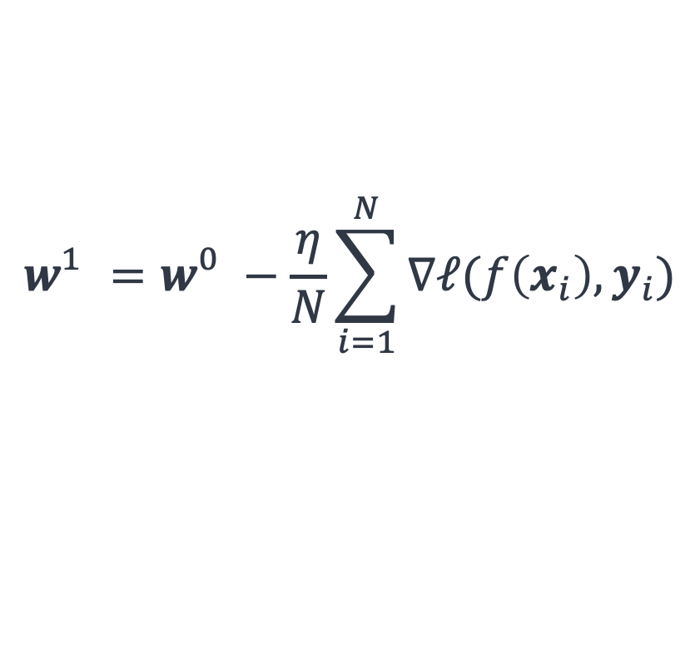
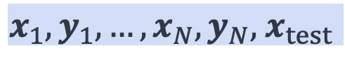





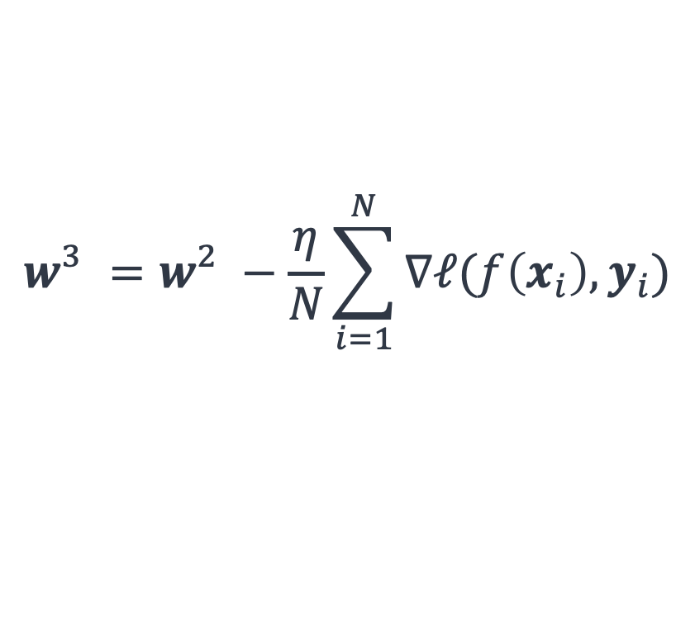


Results: Transformers can implement GD
!= does
[Von Oswald et al. 2023; others]
$${\hat{y}}_{test}$$
$${\hat{y}}_{test}=f({ x}_{test};w_{}^{3})$$
$$w_{}^{3}=w_{}^{2}−\frac{η}{N}\sum_{i=1}^{N}{∇ℓ(f\left(x_{i}\right), y_{i})}$$
$$h_{3}^{out}$$
Self-Attention Layer
$$w_{}^{2}=w_{}^{1}−\frac{η}{N}\sum_{i=1}^{N}{∇ℓ(f\left(x_{i}\right), y_{i})}$$
$$h_{2}^{}$$
Self-Attention Layer
$$w_{}^{1}=w_{}^{0}−\frac{η}{N}\sum_{i=1}^{N}{∇ℓ(f\left(x_{i}\right), y_{i})}$$
$$h_{1}^{}$$
Self-Attention Layer
$$w_{}^{0}$$
gradients of the empirical loss on the demonstrations
$$x_{1}, y_{1}, …, x_{N}, y_{N}, { x}_{test}$$
demonstrations

Slide 23
Results: Transformers can implement GD
!= does
[Von Oswald et al. 2023; others]
Theorem [von Oswald et al., among others]: There exists self-attention weights that, ICL simulates GD, for a fixed well-defined task family.
How strong of a claim are we making here? Do they hold in real practice?

Slide 24
What existing work shows:
∃
✓
Theorem [von Oswald et al., among others]: There exists self-attention weights that, ICL simulates GD, for a fixed well-defined task family.
Do the existing results generalize to realistic settings?
What is more interesting and realistic:
∀
?
Hypothesis [ICL≈GD hypothesis]: For any pre-trained Transformer weights , ICL is equivalent to GD, for any well-defined task family.

Slide 25
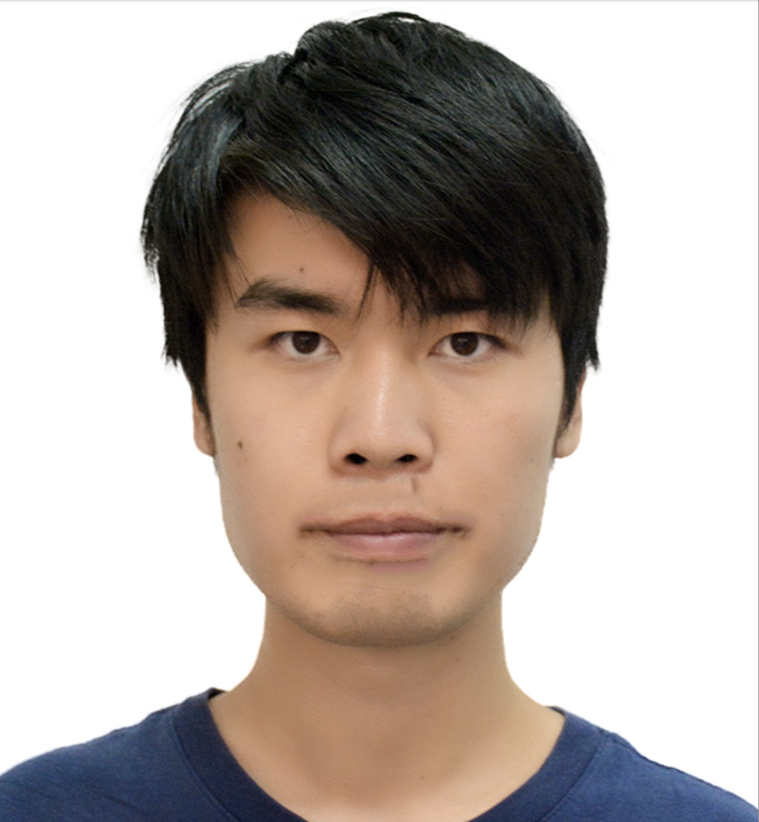

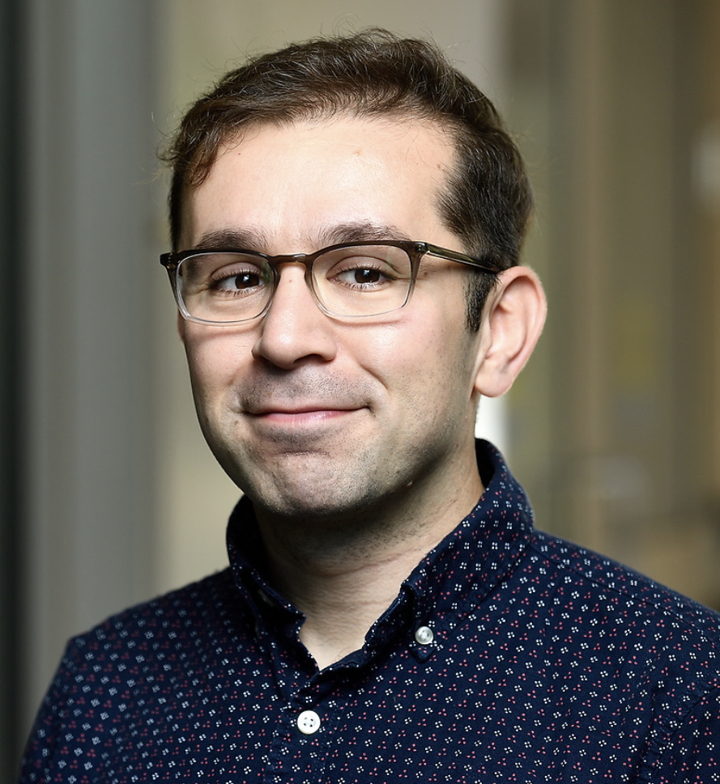
Do Pretrained Transformers Really Learn In-Context by Gradient Descent?
Lingfeng Shen, Aayush Mishra, Daniel Khashabi
https://arxiv.org/abs/2310.08540

Slide 26
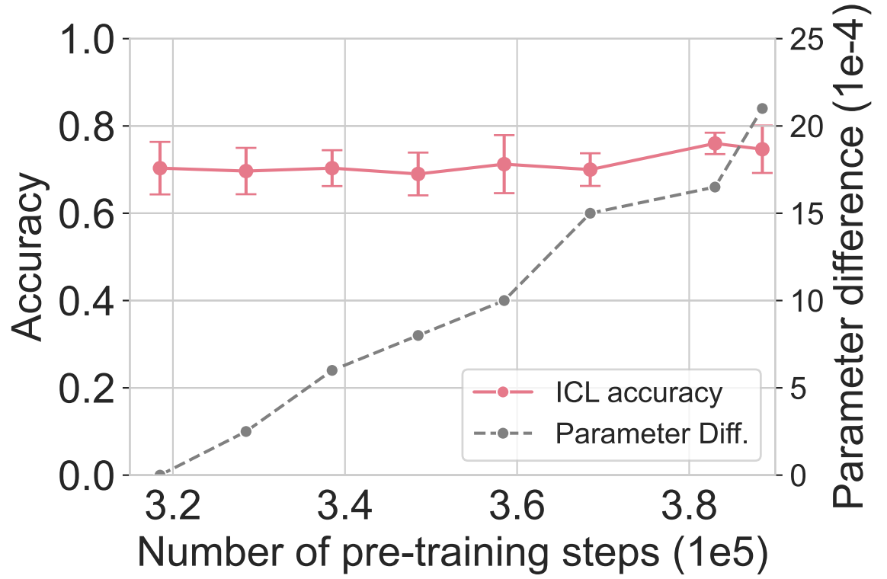
How realistic is it to proves ICL≈GD for fixed weights?
GPT-J's ICL ability does not change much over time during training, while the parameters change steadily.
There are many ICL-inducing parameters.
Therefore, to prove ICL≈GD hypothesis, showing it for a single choice of parameters is not enough.

Slide 27

ICL vs GD: End task comparison
Possible values:
World, Sports, Business, Tech
Input: Rookie Taylor Wins Playoff at Tahoe
Output:
LM
Input: Apple recalls 15in PowerBook batteries
Output: Tech
Input: Major attack by rebels on Nepalese town
Output: World
...
Input: Rookie Taylor Wins Playoff at Reno-Tahoe
Output:
In-context
demonstrations
LM
Gradient-descent
Input: Rookie Taylor Wins Playoff at Tahoe
Output:
LM

Slide 28
ICL vs GD: End task comparison
Possible values:
World, Sports, Business, Tech
Input: Apple recalls 15in PowerBook batteries
Output: Tech
Input: Major attack by rebels on Nepalese town
Output: World
...
Input: Rookie Taylor Wins Playoff at Reno-Tahoe
Output:
In-context
demonstrations
LM
Gradient-descent
Hypothesis: If two adaptation algorithms consistently lead to the same distribution on any tasks, they must be equivalent.
Input: Rookie Taylor Wins Playoff at Tahoe
Output:
LM

Slide 29
ICL vs GD: End task comparison
Possible values:
World, Sports, Business, Tech
Input: Apple recalls 15in PowerBook batteries
Output: Tech
Input: Major attack by rebels on Nepalese town
Output: World
...
Input: Rookie Taylor Wins Playoff at Reno-Tahoe
Output:
In-context
demonstrations
LM
Gradient-descent
≈
Input: Rookie Taylor Wins Playoff at Tahoe
Output:
LM
Can we take this as an evidence for ICL ≈GD?

Slide 30
Full distributions over vocabulary are quite different!
In-context
Gradient-descent
In-context
LM
Gradient-descent
LM
ICL vs GD modify LLM distributions differently..

Slide 31
In-context
Gradient-descent
Overlap(k=10)=50%
top-k
Overlap(k): % commonality across top-k tokens of two distributions

Slide 32
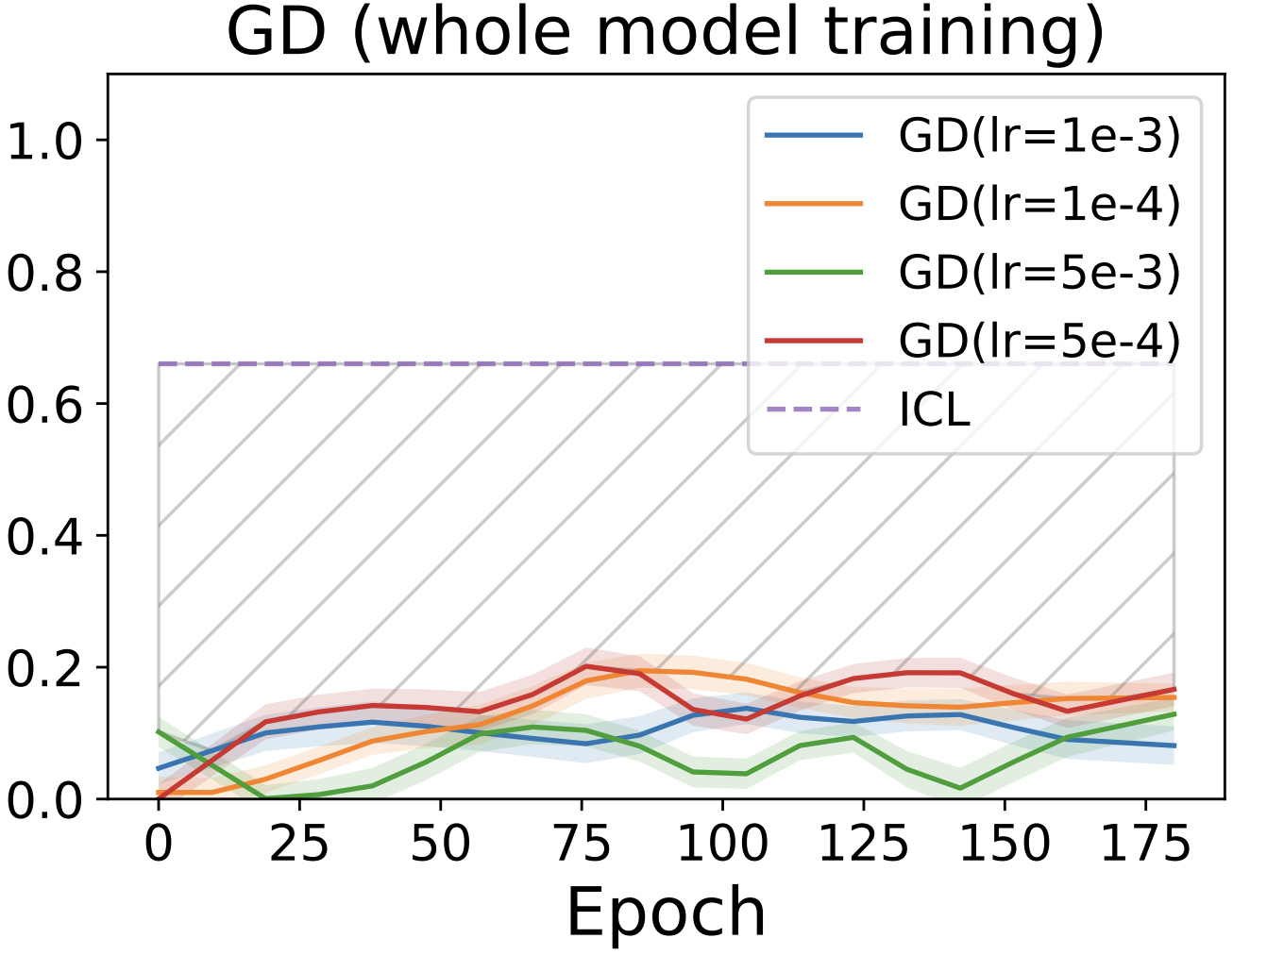

ICL vs GD modify LLM distributions differently.
ICL vs GD (lr=1e-3)
ICL vs GD (lr=1e-4)
ICL vs GD (lr=1e-5)
ICL vs GD (lr=1e-6)
ICL vs ICL
Overlap(k=10)

Slide 33
ICL vs GD modify LLM distributions differently.
Overlap(K)

Slide 34
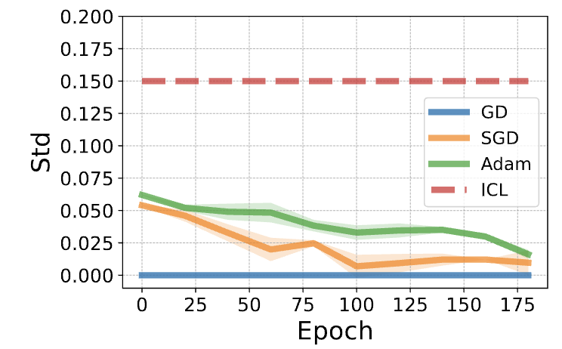
ICL vs GD have different order-sensitivity.
Prior research has demonstrated that ICL is highly sensitive to the order of in-context sample [Lu et al. 2022].
GD and its variants is more order-stable (less STD).
Standard deviation token probabilities, for different choices of demonstrations.

Slide 35
Summary Thus Far
The explanations of ICL based on GD are quite intriguing — do they hold in practice?
In practice, we did not see any evidence that ICL simulates GD.
See the paper for more arguments and analysis.
Note, we’re not refuting it. It’s left open for future research.
Deep inside, I believe that there must be a connection between ICL and optimization algorithms — we’re just not looking at it right.

Slide 36
ICL remains understudied and elusive.
ICL is the most important & mysterious phenomenon.
… we don’t know how to explain it.
… and we are getting used to it.
Many open problems:
Under what conditions does it emerge? (e.g., distributional properties)
Does ICL need natural language? Can it emerge, e.g., on brain signals?

Slide 37
ICL is likely what makes “alignment” effective.
The success of LLMs in following instructions can be viewed from the lens of ICL.
Being able to make LLMs adapt to various in-context demonstration was an early sign that LLMs can be controlled.
To understand limits of controlling LLMs, we must understand limits of ICL.

Slide 38
Today
Revisiting …
In-Context Learning
Alignment of chatbots

Slide 39
Today
Revisiting …
In-Context Learning
Alignment of chatbots

Slide 40
Language Modeling ≠ Following User Intents
Background
Explain gravity to a 6-year-old.
Explain black-holes to a 6-year-old.
Explain big bang to a 6-year-old.
….
Explain ”space elevators” to a 6-year-old.
LM
LMs are not “aligned” with user intents [Ouyang et al., 2022].
[Training language models to follow instructions with human feedback, Ouyang et al. 2022]

Slide 41
How do we “align” LMs with our articulated intents?
Background

Slide 42
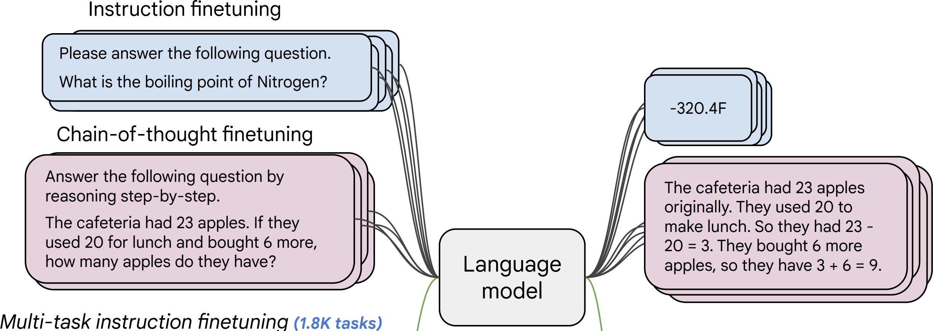
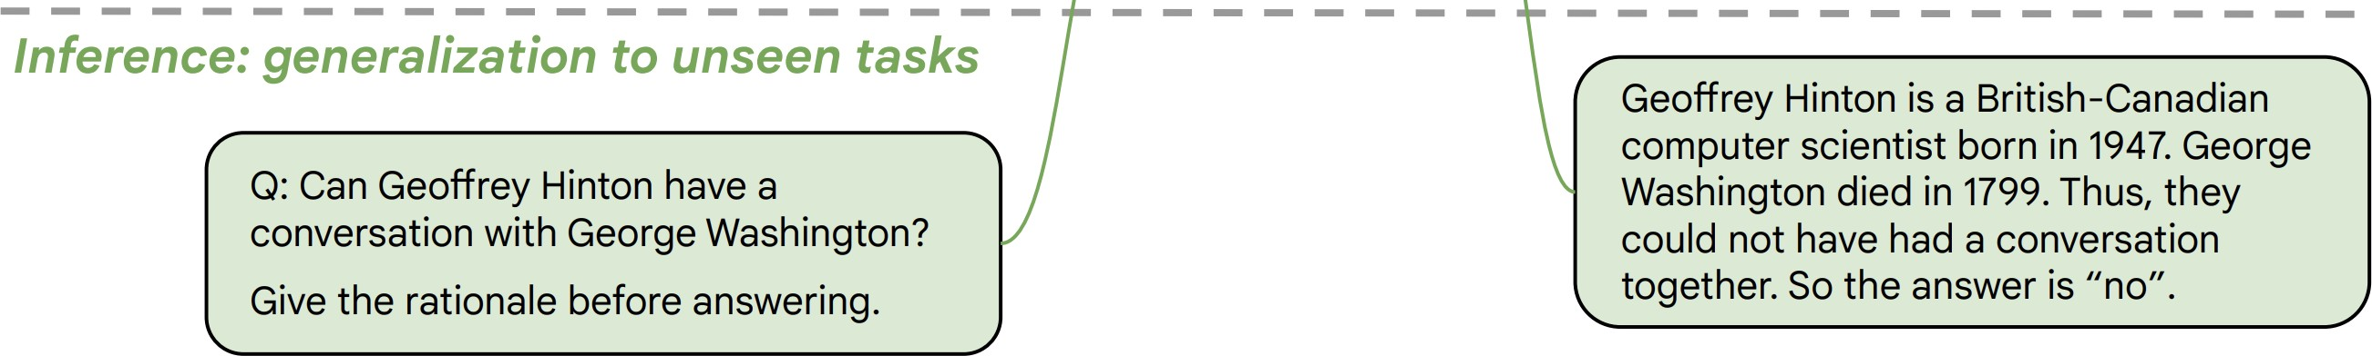
Approach 1: Behavior Cloning (Supervised Learning)
Background
Collect examples of (instruction, output) pairs across many tasks and finetune an LM
2. Evaluate LM on unseen tasks
LM
[McCann et al., 2019, Weller et al. 2020. Mishra et al. 2021; Wang et al. 2022, Sanh et al. 2022; Wei et al., 2022, Chung et al. 2022, many others ]

Slide 43
Approach 1: Behavior Cloning (Supervised Learning)
Background
Incentivizes word-by-word rote learning => limits creativity
=> The resulting models’ generality/creativity is bounded by that of their supervision data.
LM
[McCann et al., 2019, Weller et al. 2020. Mishra et al. 2021; Wang et al. 2022, Sanh et al. 2022; Wei et al., 2022, Chung et al. 2022, many others ]

Slide 44
Approach 2: RL w/ Ranking Feedback (RLHF)
Background
1. Reward Learning
2. Policy Gradient
R
It is like any typical elevator, but it goes to space. …
👍
👎
Explain ”space elevators” to a 6-year-old.
LM
👩
Explain gravity to a 6-year-old. …
Explain ”space elevators” to a 6-year-old.
LM
It is basically ….
R
[Christiano et al. 2017; Stiennon et al. 2020; Ouyang et al., 2022]

Slide 45
The overall recipe 👨‍🍳:
Background
Pre-train
Align (instruct-tune)
Align (RLHF)

Slide 46
The overall recipe 👨‍🍳:
Background
Pre-train
Align (instruct-tune)
Align (RLHF)

Slide 47
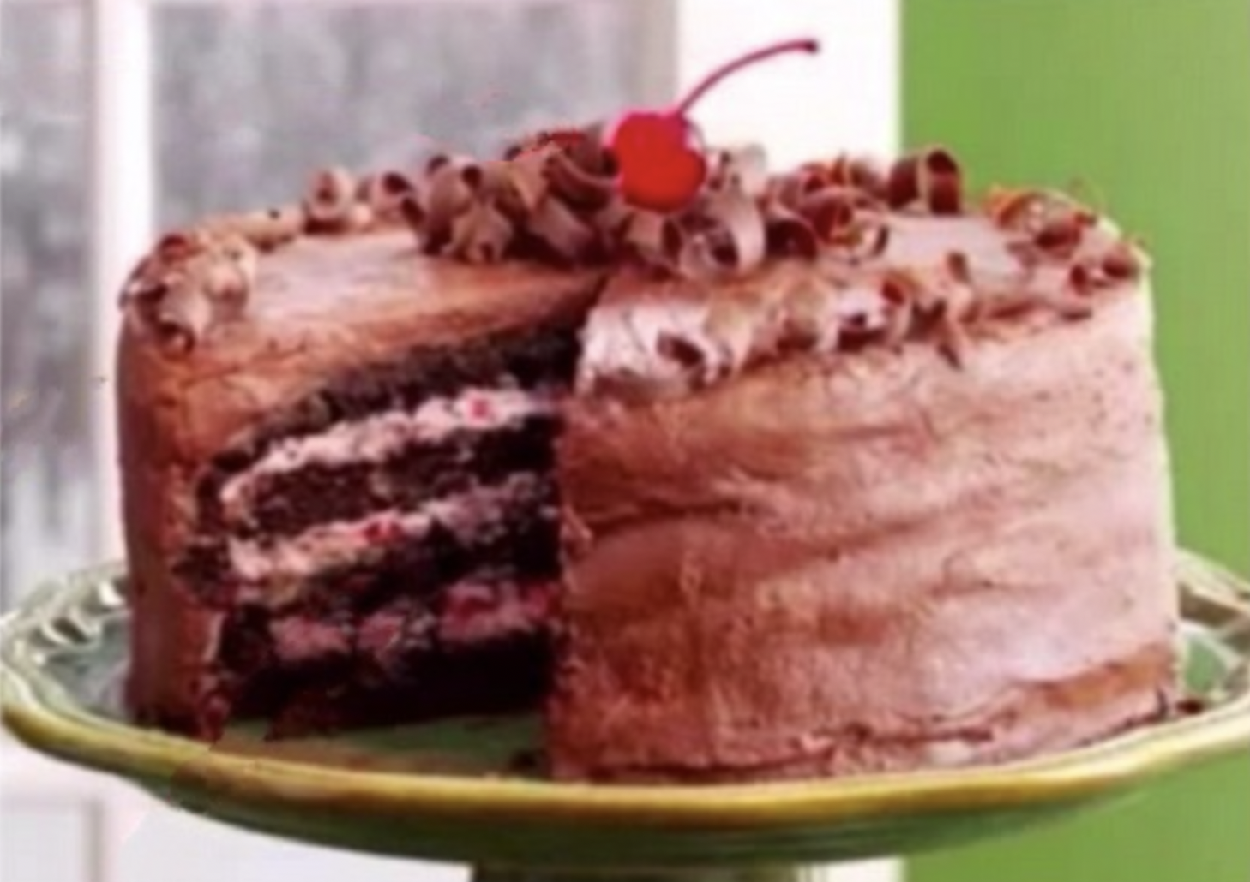

The overall recipe 👨‍🍳: Yann’s Three-layered cake
Background
Pre-train
Align (instruct-tune)
Align (RLHF)
Icing
Cherry on the cake
Cake génoise
Notes:
- cake genoise: learning representation of the world.
- Icing (predicting human-supplied data)
- cherry on the topic

Slide 48
Are these steps equally important?
Pre-train
Align (instruct-tune)
Align (RLHF)

Slide 49
Are these steps equally important?
Pre-train
Align (instruct-tune)
Align (RLHF)
Who should care?
Product designers: If you have $X million to build your best chatbot, how would you allocate it?
Scientists: Fundamentally, is this the ultimate pipeline?
[Brown et al., 2020. GPT3, Ouyang et al., 2022. InstructGPT]

Slide 50
Are these steps equally important?
Pre-train
Align (instruct-tune)
Align (RLHF)
Pretraining
(GPT3: 499 Billion tokens)
Fine-tuning
(InstructGPT-001: 44K examples)
[Brown et al., 2020. GPT3, Ouyang et al., 2022. InstructGPT]

Slide 51
Are these steps equally important?
Pre-train
Align (instruct-tune)
Align (RLHF)
$1.8M
~$1M
AI Index 2023
🗣
70k x $15
[Brown et al., 2020. GPT3, Ouyang et al., 2022. InstructGPT]
Notes:
Monetary cost
Another way of looking at what we’re trying to do here is:
If I give you 2.8M to build a model that is better than this model by OpenAI, how would you spend it?

Slide 52
Are these steps equally important?
Pre-train
Align (instruct-tune)
Align (RLHF)
How far can we reduce the human annotations?

Slide 53
How far can we reduce the human annotations?
Idea: we can bootstrap “instruction” from off-the-shelf LMs.
LMs have seen humans talk about their needs and goals.
Pretraining
(GPT3*: 499 Billion tokens)
LLMs should know a lot of tasks!

Slide 54


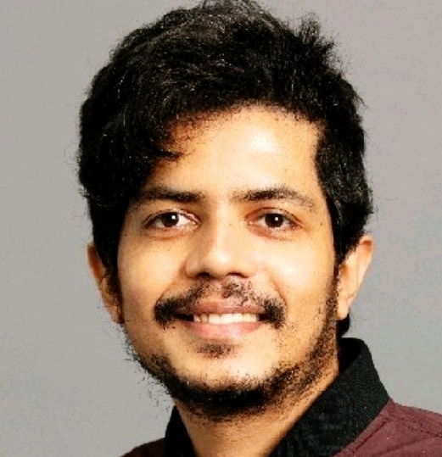
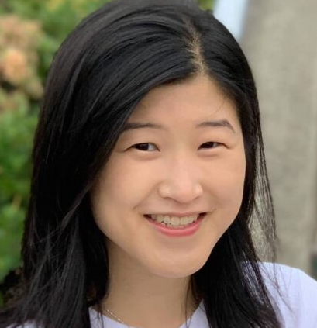
Self-Instruct: Aligning Language Models w/ Self-Generated Instructions
Warning: the paper is a year old!!
Yizhong Wang, Yeganeh Kordi, Swaroop Mishra, Alisa Liu,
Noah A. Smith, Daniel Khashabi, Hannaneh Hajishirzi
https://arxiv.org/abs/2212.10560

Slide 55
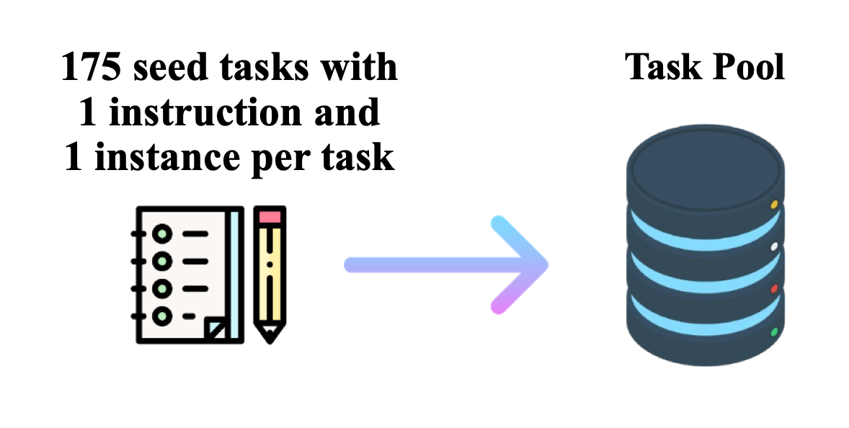
Get humans to write ”seed” tasks ✍️
I am planning a 7-day trip to Seattle. Can you make a detailed plan for me?
Is there anything I can eat for breakfast that doesn’t include eggs, yet includes protein and has roughly 700-1000 calories?
Given a set of numbers find all possible subsets that sum to a given number.
Give me a phrase that I can use to express I am very happy.
175 seed tasks

Slide 56
Put them your task bank 📦
I am planning a 7-day trip to Seattle. Can you make a detailed plan for me?
Is there anything I can eat for breakfast that doesn’t include eggs, yet includes protein and has roughly 700-1000 calories?
Given a set of numbers find all possible subsets that sum to a given number.
Give me a phrase that I can use to express I am very happy.
175 seed tasks
task pool

Slide 57
Sample and get LLM to expand it
I am planning a 7-day trip to Seattle. Can you make a detailed plan for me?
Is there anything I can eat for breakfast that doesn’t include eggs, yet includes protein and has roughly 700-1000 calories?
Given a set of numbers find all possible subsets that sum to a given number.
Give me a phrase that I can use to express I am very happy.
LM
Pre-trained, but not aligned yet
Create a list of 10 African countries and their capital city?
Looking for a job, but it’s difficult for me to find one. Can you help me?
Write a Python program that tells if a given string contains anagrams.
175 seed tasks
task pool
📝
LM suggests new tasks

Slide 58
Get LLM to answers the new tasks
Task: Convert the following temperature from Celsius to Fahrenheit.
Input: 4 °C
Output: 39.2 °F
Task: Write a Python program that tells if a given string contains anagrams.
LM
Pre-trained, but not aligned yet
Input: -
Output: def isAnagram(str1, str2): ...
175 seed tasks
task pool
📝
📝
LM suggests new tasks
LM suggests answers

Slide 59
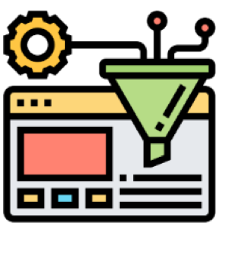
Filter tasks
Drop tasks if LM assigns low probability to them.
Drop tasks if they have a high overlap with one of the existing tasks in the task pool.
Otherwise, common tasks become more common — tyranny of majority.
175 seed tasks
task pool
LM suggests answers
📝
📝
LM suggests new tasks
LM suggests answers
filter out if not novel or confident

Slide 60
Close the loop
Add the filtered tasks to the task pool.
Iterate this process (generate, filter, add) until yield is near zero.
task pool
175 seed tasks
LM suggests answers
📝
📝
LM suggests new tasks
LM suggests answers
filter out if not novel or confident

Slide 61
Self-Instructing GPT3 (base version)
Generate:
GPT3 (“davinci” engine).
We generated 52K instructions and 82K instances.
API cost ~$600
Align:
We finetuned GPT3 with this data via OpenAI API (2 epochs). **
API cost: ~$338 for finetuning
task pool
175 seed tasks
LM suggests answers
📝
📝
LM suggests new tasks
LM suggests answers
filter out if not novel or confident

Slide 62
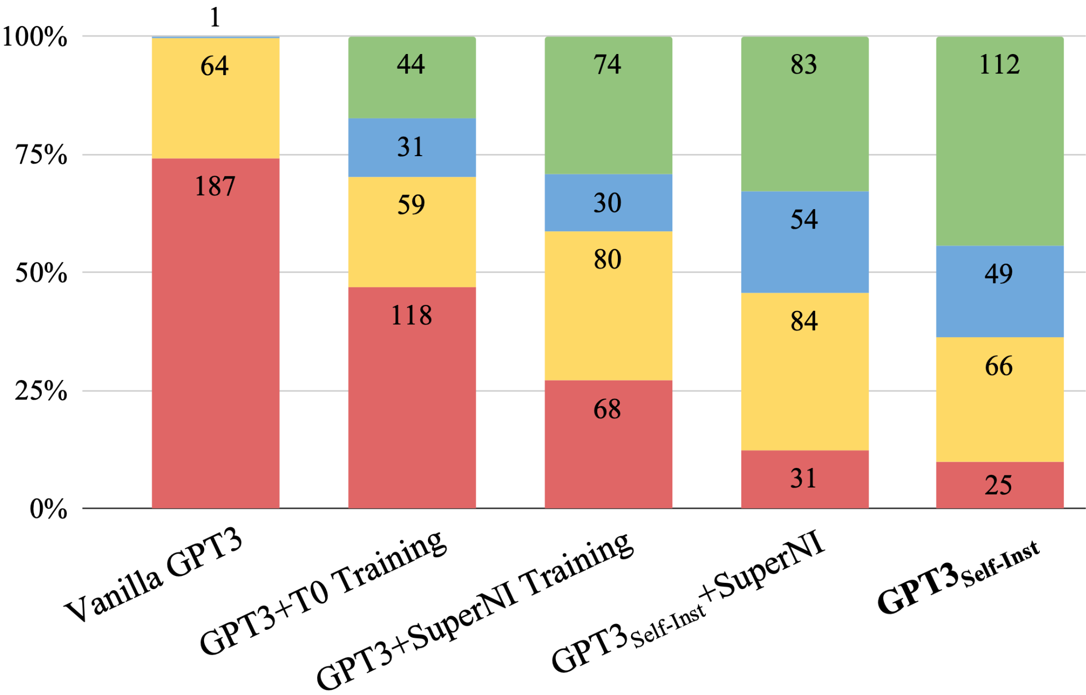
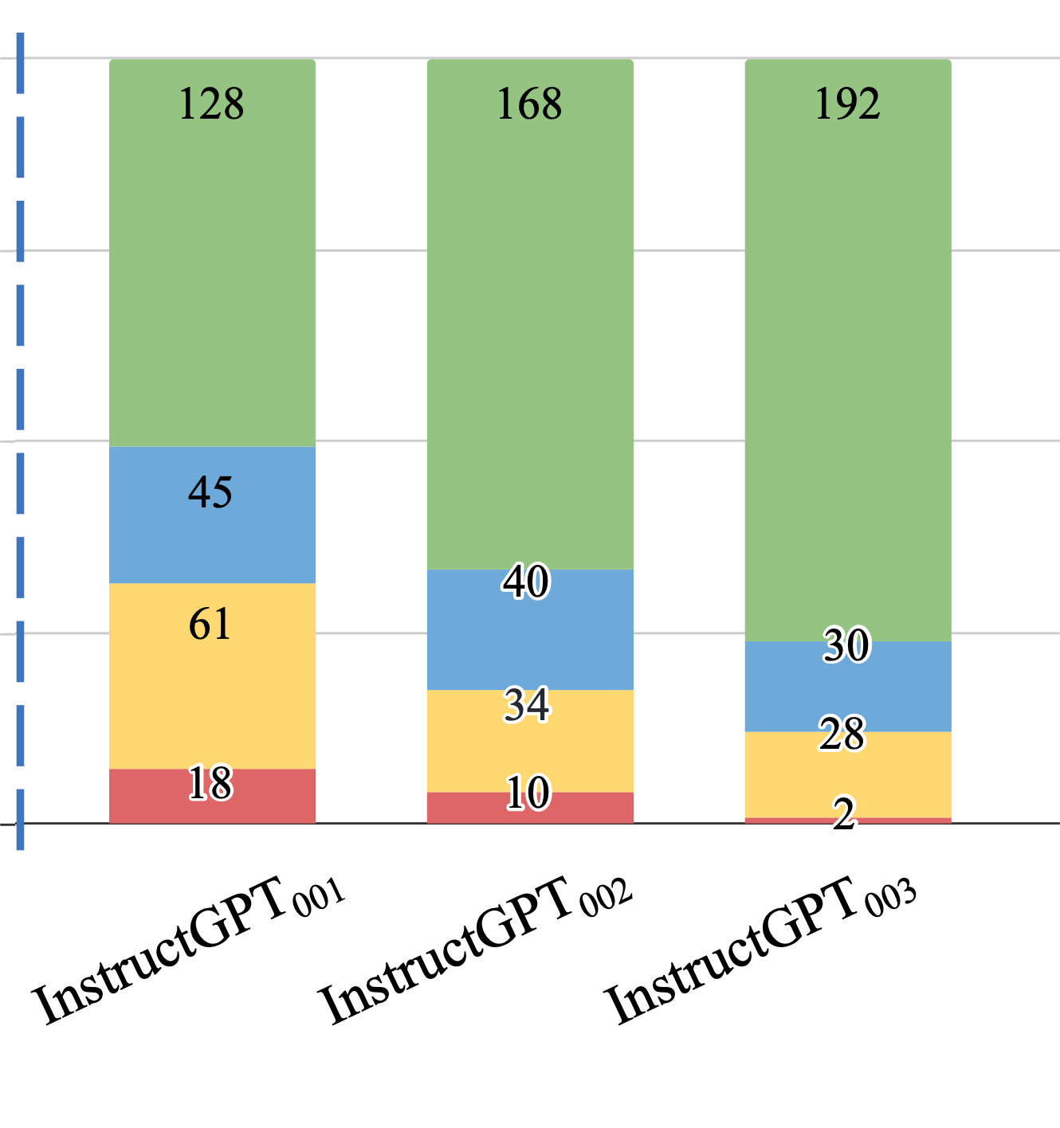
Evaluation on User-Oriented Instructions
LM pretraining
vanilla GPT3 (davinci)
+ instruct-tuning
GPT3-instruct (davinci-001)
Diverse, “self-instruct” data ~ thousands of human-written data
[Self-Instruct: Aligning Language Model with Self-Generated Instructions, Wang et al. 2023]

Slide 63
Summary Thus Far
There is a lot of room to reduce the reliance on human annotations in the “alignment” stage.
Well-read LLMs know a lot of our needs and demands.
Magic of “in-context learning” can surface these.
Self-Instruct: Rely on creativity induced by LLMs themselves.
Lots of open-source adoption, but that’s not the point …
(* See also concurrent work: Unnatural-Instructions [Honovich et al. 2022] and Self-Chat [Xu et al. 2023] )

Slide 64
The weight of “alignment” step
Fundamentally, what is the role of post hoc alignment (step #2/3)?
Step #1:
Pre-train
Step #2/3: Align (RLHF or instruction-tune)
It’s playing a small role —
Lightly modify LM so it can articulate its existing knowledge of tasks.
It’s playing a big role — Teaching LM knowledge of new tasks.
(+ put guardrails for what it can articulate)

Slide 65
Implications for how to invest
Fundamentally, what is the role of post hoc alignment (step #2/3)?
Step #1:
Pre-train
Step #2/3: Align (RLHF or instruction-tune)
Make it more efficient, possibly with minimal human labor.
It ought to be annotation-intensive to teach the necessary knowledge.
It’s playing a small role —
Lightly modify LM so it can articulate its existing knowledge of tasks.
It’s playing a big role — Teaching LM knowledge of new tasks.
(+ put guardrails for what it can articulate)

Slide 66
Implications for what comes out
Fundamentally, what is the role of post hoc alignment (step #2/3)?
Step #1:
Pre-train
Step #2/3: Align (RLHF or instruction-tune)
Unexpected behaviors may “emerge”.
It will be as good as the alignment supervision.
It’s playing a small role —
Lightly modify LM so it can articulate its existing knowledge of tasks.
It’s playing a big role — Teaching LM knowledge of new tasks.
(+ put guardrails for what it can articulate)

Slide 67
The weight of “alignment” step: My 2 cents
Most of the heavy lifting is done via pre-training (unlabeled).
Alignment to “instructions” (tuning/RLHF) is a light touch on LLMs.
Can (and should) be done more efficiently.
It’s playing a small role —
Lightly modify LM so it can articulate its existing knowledge of tasks.
It’s playing a big role — Teaching LM knowledge of new tasks.
(+ put guardrails for what it can articulate)

Slide 68


RLHF is patchwork for lack of grounding
RLHF teach LMs (ground) the communicative intent of users.
For example, what is intended by “summarize”? The act of producing a summary grounded in the human concept of "summary”.
Not a panacea, but a short-term “band-aid” solution.
Intents and norms
RLHF or instruct-tuning
LM
[Some remarks on Large Language Models, Goldberg 2023]

Slide 69
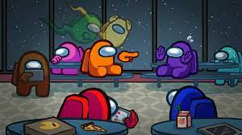
Alignment as a social process
Can alignment emerge as a social experience?
Internet also captures a subset of the world’s interactive experiences.

Slide 70
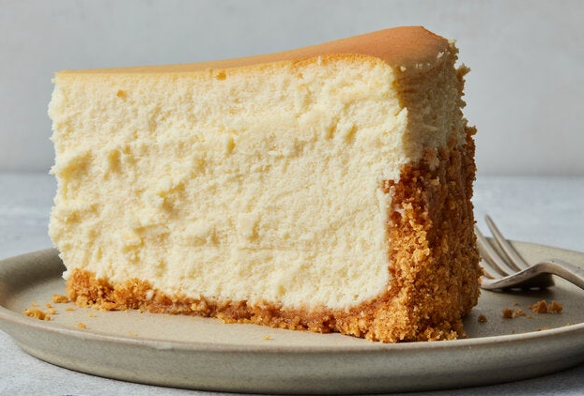
The future is a cheesecake
Future: A unifying process that encompasses various steps that are done separately today.
The margins between alignment stages are getting murkier.
Using model itself for feedback and verification
Alignment during pre-training (Korbak et al. 2023)
Building bridges between supervised learning and RL (see DPO vs. RLHF)
…
Pre-train
Align (instruct-tune)
Align (RLHF)

Slide 71
The future is a cheesecake
Future: A unifying process that encompasses various steps that are done separately today.
Yann’s framework was good for getting a system off the ground.
Now that we are moving to interactive setups, alignment and pre-training will be a continual process. Systems that :
Adaptively change to our needs and habits;
Seamlessly pick up on implicit reward;
….

Slide 72
Thanks!

